Slide 1
TSPI File Fixer Tool
Jeff Hole
Booz | Allen | Hamilton
AFLCMC / EZJA
1-6-2020

Slide 2
First things first
Add the folder where “tspi_class.m” resides to the MATLAB path
addpath(‘/path/to/tspi_fixer_tool’)
Create a MATLAB script with the following:
filename = ‘/path/to/TSPI/filename.csv’;
tp = tspi_class(filename);
% update any search strings specific to the TSPI file
tp.searchString_wgs84_alt = ‘GEOHT84’;
% call the fixer tool (runs an interactive tool)
tp.fix_TSPI(‘platform’,1,’run’,1);

Slide 3
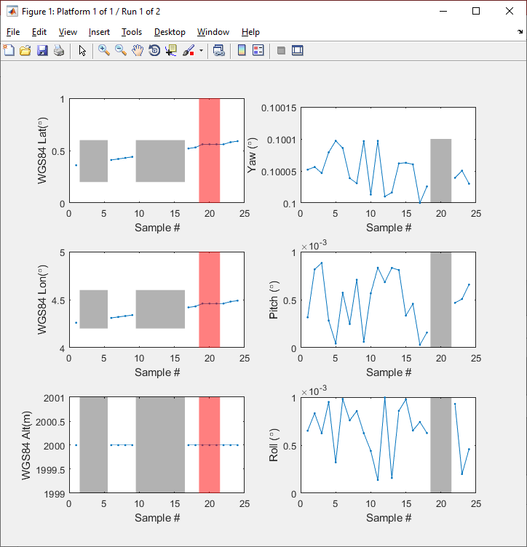
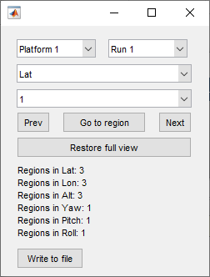
Here’s what the script makes…
Companion tool

Slide 4
Highlighted Problem Regions
The tool currently checks for
[gray] Empty entries in the flightpath
[red] Stale entries
Where all three values (LLA or YPR) are constant

Slide 5
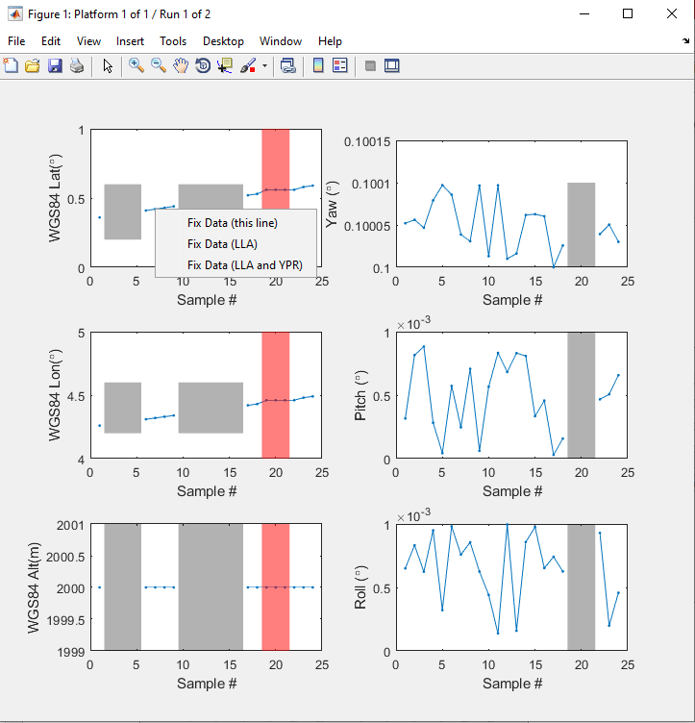

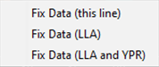
How To Use
Right click on the line you want to modify to expose a number of options
Fix Data (this line)
Only fix the selected line
Fix Data (LLA)
Points selected on the active line will be used to find the corresponding points on the other two in the LLA group
Fix Data (LLA and YPR)
Risky, but useful if a particular region is consistent across all 6 data sets.

Slide 6
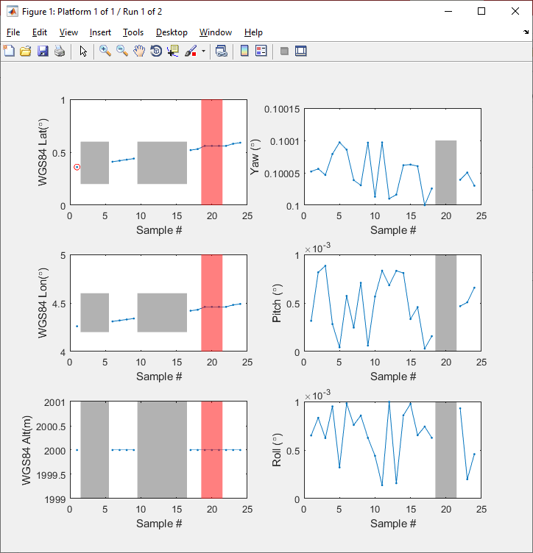

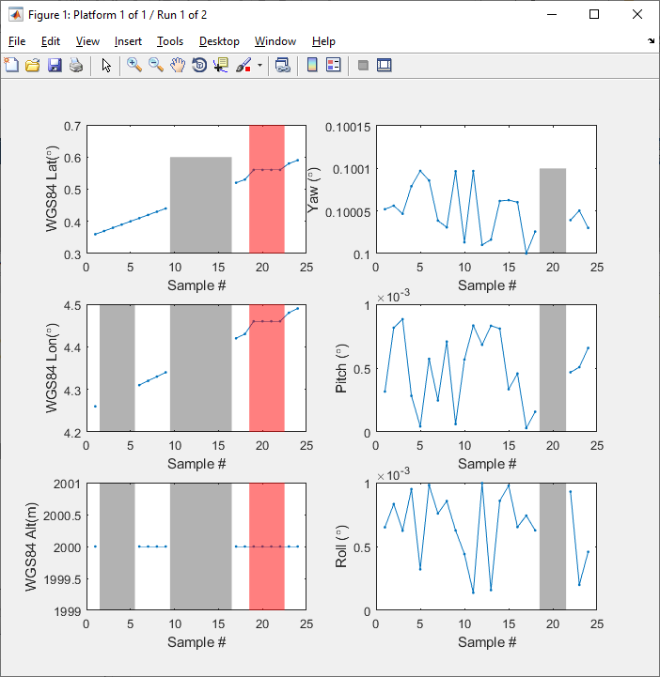
How To Use Fix Data (this line)

Slide 7
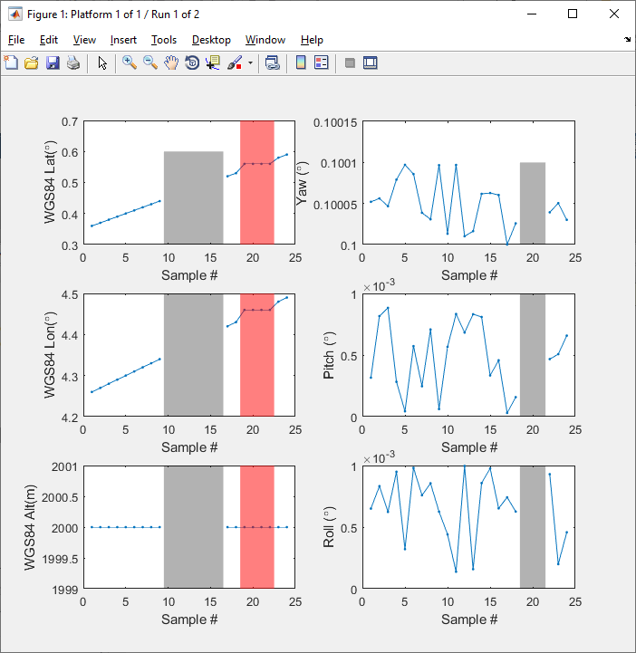
How To Use Fix Data (LLA)

Slide 8

How To Use Fix Data (LLA and YPR)
In this case, there was no issue in the YPR at the same region, so this option was not a good choice. It was shown here as an example only to show the effect.

Slide 9
Using the companion tool
Platform selection
Run selection
Region navigation (good for navigating long runs with many problem areas)
Restore the full (widest) view of the run data (useful for getting big picture while using the region navigation tools in C)
Fixing status indicators (how many problem regions are still present in each data set)
When finished with any/all of the platform/run combinations, can click this button to save off a new TSPI file.
BOTTOM LINE:
Only need to use this for selecting PLATFORM (A) and RUN NUMBER (B), and writing the final TSPI file (F)
Otherwise, zooming into regions to fix can be done with the standard zoom/pan tools in the figure.
A
B
C
D
E
F

